Slide 1
Solving systems of linear equations. Gauss and Jordan-Gauss elimination.
Matrices in row-echelon and reduced row-echelon form

Slide 2
Gaussian Elimination
In general, to solve a system of linear equations using its augmented matrix, we use elementary row operations to arrive at a matrix in a certain form.
This form is described as follows.

Slide 3
Row-Echelon Form
A matrix is in row-echelon form if it satisfies the following conditions.
The first nonzero number in each row (reading from left to right) is 1. This is called the leading entry.
The leading entry in each row is to the right of the leading entry in the row immediately above it.
All rows consisting entirely of zeros are at the bottom of the matrix.

Slide 4
Reduced Row-Echelon Form
A matrix is in reduced row-echelon form if it is in row-echelon form and also satisfies the following condition.
4. Every number above and below each leading entry is a 0.

Slide 5
Is the following matrix in row-echelon form?

Slide 6
Row-Echelon & Reduced Row-Echelon Forms
Row-Echelon Form | Reduced Row-Echelon Form

Slide 7
Expressing in Row-Echelon Form
We now discuss a systematic way to put a matrix in row-echelon form using elementary row operations.
We see how the process might work for a 3 x 4 matrix.

Slide 8
Putting in Row-Echelon Form—Step 1
Start by obtaining 1 in the top left corner.
Then, obtain zeros below that 1 by adding appropriate multiples of the first row to the rows below it.

Slide 9
Putting in Row-Echelon Form—Steps 2 & 3
Next, obtain a leading 1 in the next row.
Then, obtain zeros below that 1.
At each stage, make sure every leading entry is to the right of the leading entry in the row above it.
Rearrange the rows if necessary.

Slide 10
Expressing in Row-Echelon Form—Step 4
Continue this process until you arrive at a matrix in row-echelon form.

Slide 11
Expressing in Reduced Row-Echelon Form—Step 1
Use the elementary row operations to put the matrix in row-echelon form.

Slide 12
Expressing in Reduced Row-Echelon Form—Step 2
Obtain zeros above each leading entry by adding multiples of the row containing that entry to the rows above it.

Slide 13
Expressing in Reduced Row-Echelon Form—Step 2
Begin with the last leading entry and work up.

Slide 14

Solving a system with unique solution by using the reduced row echelon matrix
Ex. Let’s assume that a linear system with 4 variables has been reduced to the following matrix
$\left[\begin{aligned}1 0 0 0 2 \\ 0 1 0 0 5 \\ 0 0 1 0−1 \\ 0 0 0 1 7\end{aligned}\right]$
Then, the solution can be found in the last column of the matrix, as follows:
$x_{1}=2$
$x_{2}=5$
$x_{3}=−1$
$x_{4}=7$
The system has a unique solution.

Slide 15
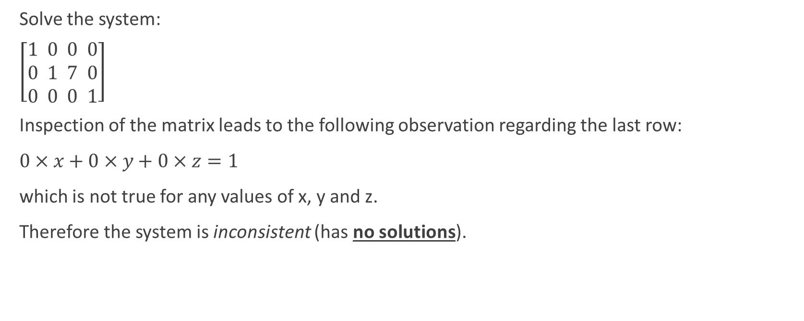
Solving a system with no solutions by using the reduced row echelon matrix
Solve the system:
$\left[\begin{aligned}1 0 0 0 \\ 0 1 7 0 \\ 0 0 0 1\end{aligned}\right]$
Inspection of the matrix leads to the following observation regarding the last row:
$0×x+0×y+0×z=1$
which is not true for any values of x, y and z.
Therefore the system is inconsistent (has no solutions).

Slide 16

Solving a system with infinitely many solutions using the row echelon matrix
Solve the system:
$\left[\begin{aligned}1 0 2 5 \\ 0 1 −1 3 \\ 0 0 0 0\end{aligned}\right]$
We can transpose the matrix into the following linear system:
$x+2z=5$
$y−z=3$
The last equation can be ignored, since it is just stating the obvious 0=0.

Slide 17
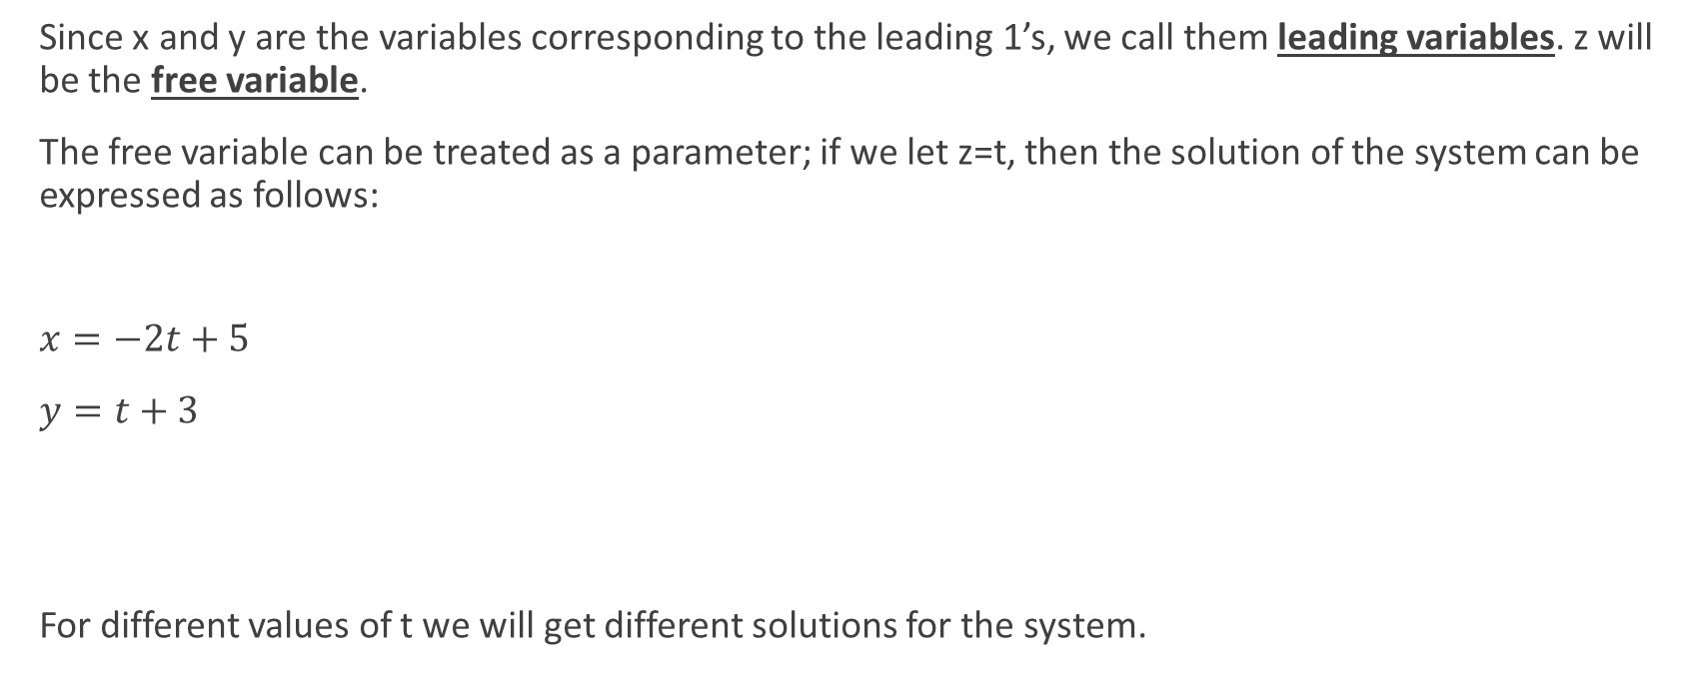
Continued
Since x and y are the variables corresponding to the leading 1’s, we call them leading variables. z will be the free variable.
The free variable can be treated as a parameter; if we let z=t, then the solution of the system can be expressed as follows:
$x=−2t+5$
$y=t+3$
For different values of t we will get different solutions for the system.

Slide 18

Practice
Solve the system:
$\left[\begin{aligned}1 3 −2 4 \\ 0 0 0 0 \\ 0 0 0 0\end{aligned}\right]$

Slide 19
Gaussian Elimination
Once an augmented matrix is in row-echelon form, we can solve the corresponding linear system using back-substitution.
This technique is called Gaussian elimination, in honor of its inventor, the German mathematician C. F. Gauss.

Slide 20
Solving a System Using Gaussian Elimination
To solve a system using Gaussian elimination, we use:
Augmented matrix
Row-echelon form
Back-substitution

Slide 21

Solve the following system using Gaussian elimination.
$x_{1}+x_{2}+2x_{3}=8$
$−x_{1}−2x_{2}+3x_{3}=1$
$3x_{1}−7x_{2}+4x_{3}=10$

Slide 25
Gauss-Jordan Elimination

Slide 26
Gauss-Jordan Elimination
Using the reduced row-echelon form to solve a system is called Gauss-Jordan elimination.
Use this process to solve the next linear system.

Slide 27

Solve the system used in the previous example by using Gauss-Jordan elimination
$x_{1}+x_{2}+2x_{3}=8$
$−x_{1}−2x_{2}+3x_{3}=1$
$3x_{1}−7x_{2}+4x_{3}=10$

Slide 30
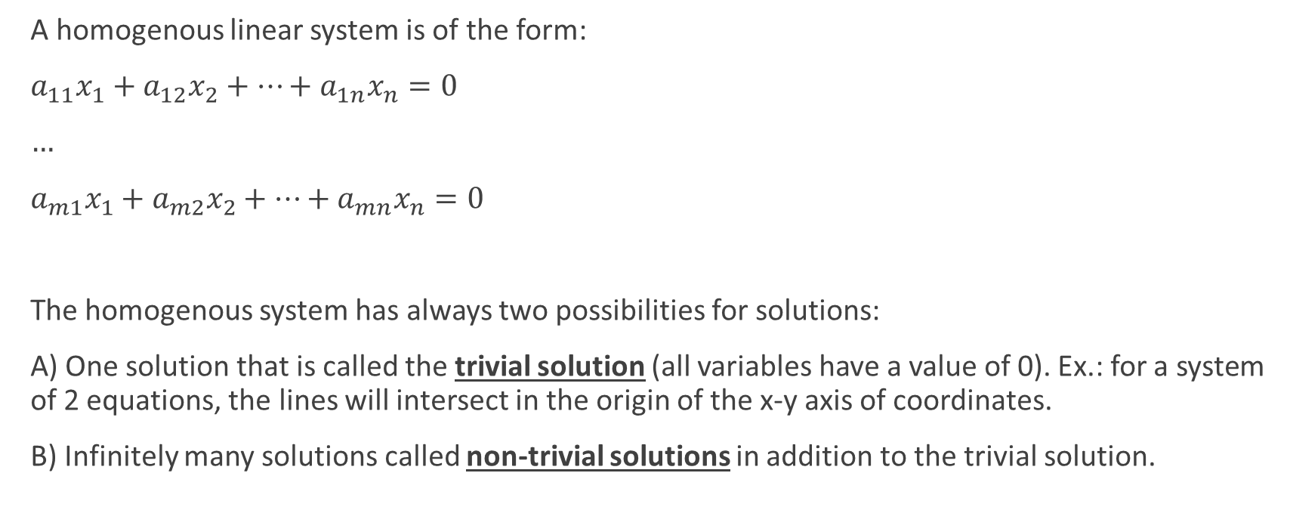
Solving systems of homogeneous linear equations
A homogenous linear system is of the form:
$a_{11}x_{1}+a_{12}x_{2}+…+a_{1n}x_{n}=0$
$…$
$a_{m1}x_{1}+a_{m2}x_{2}+…+a_{mn}x_{n}=0$
The homogenous system has always two possibilities for solutions:
A) One solution that is called the trivial solution (all variables have a value of 0). Ex.: for a system of 2 equations, the lines will intersect in the origin of the x-y axis of coordinates.
B) Infinitely many solutions called non-trivial solutions in addition to the trivial solution.

Slide 31
Theorem 1. A homogenous linear system with more unknowns than equations will have infinitely many solutions.
Observation. These solutions will be expressed in terms of parameters.
Theorem 2. Free Variable theorem for homogenous systems.
If a homogenous linear system has n unknowns, and if the reduced echelon form of its augmented matrix has r non-zero rows, then the system has n-r free variables.

Slide 32
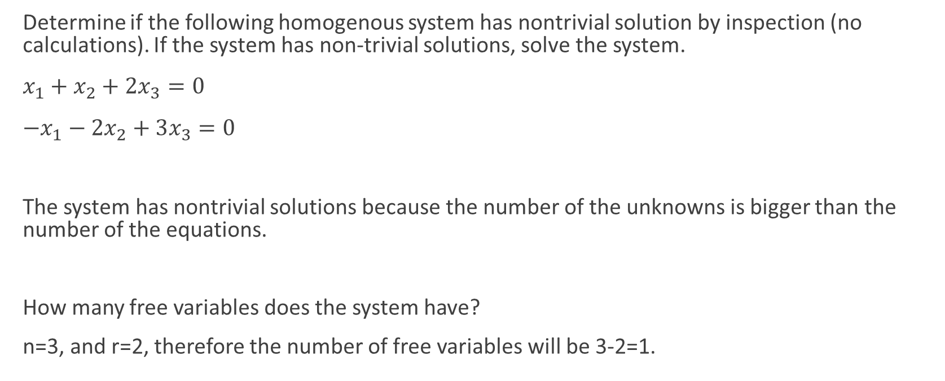
Example
Determine if the following homogenous system has nontrivial solution by inspection (no calculations). If the system has non-trivial solutions, solve the system.
$x_{1}+x_{2}+2x_{3}=0$
$−x_{1}−2x_{2}+3x_{3}=0$
The system has nontrivial solutions because the number of the unknowns is bigger than the number of the equations.
How many free variables does the system have?
n=3, and r=2, therefore the number of free variables will be 3-2=1.

Slide 33

Practice
1. Solve by Jordan - Gauss
$2y+z=4$
$x+y+2z=6$
$2x+y+ z=7$

Slide 37

2.
$x−2y+z=0$
$2x+y−3z=5$
$4x−7y+z= −1$

Slide 41

$3.$
$2x−4y+5z=0$
$−3x+2y−3z=0$

Slide 44

4.
$x+9y −z=27$
$x −8y+16z=10$
$2x+y+15z=37$

